Slide 1


Slide 2
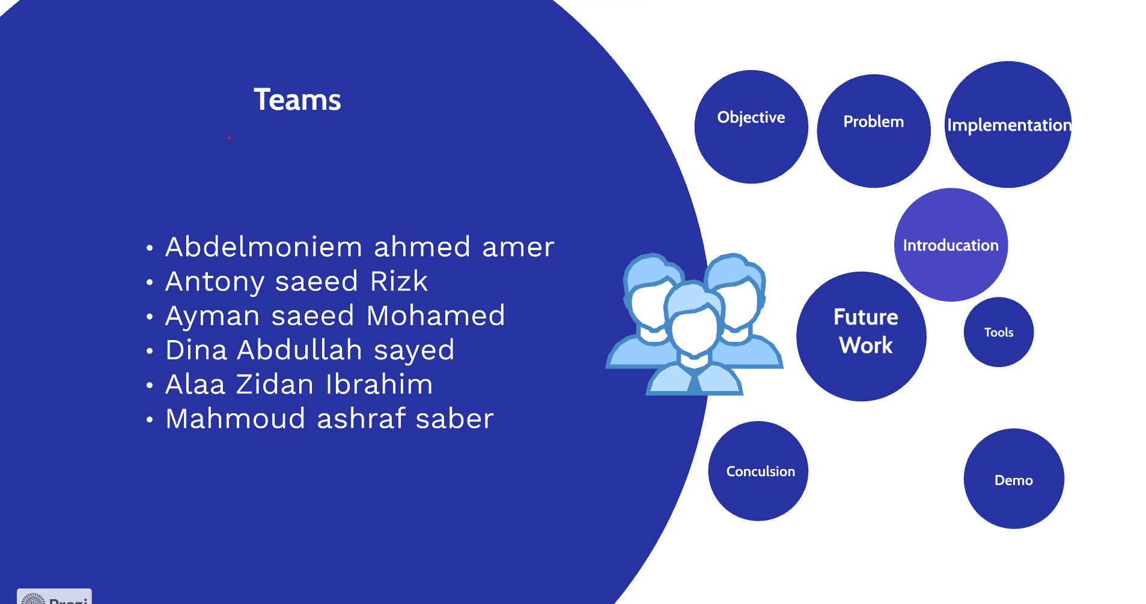

Slide 3
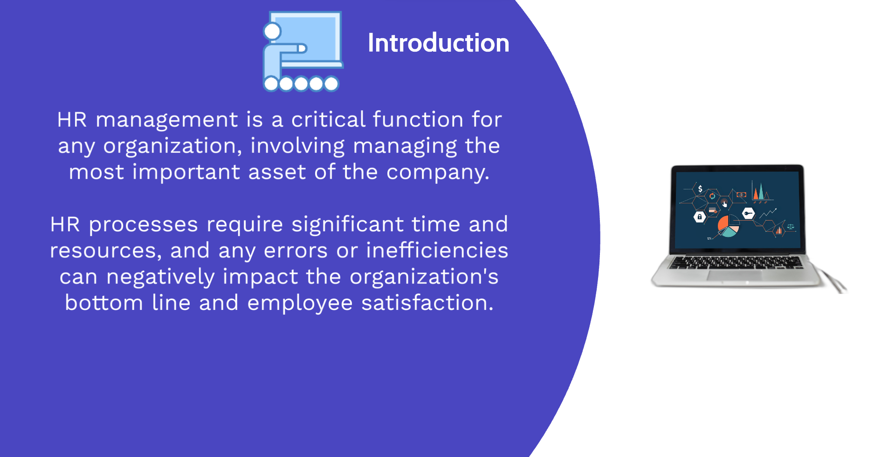
Agenda
Introduction
Project Overview
Implementation
Tools
Challenges and Solutions
Demo
Conclusion

Slide 4
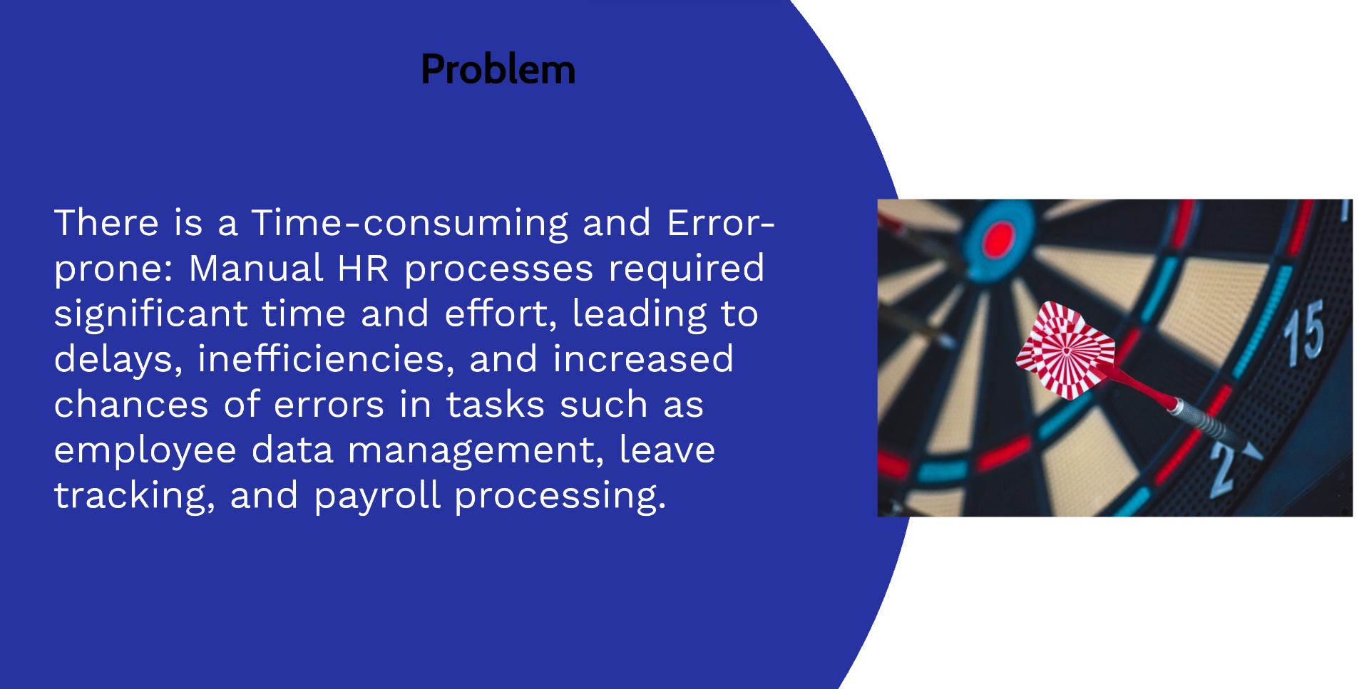
Introduction
HR management is a critical function for any organization, involving managing the most important asset of the company.
HR processes require significant time and resources, and any errors or inefficiencies can negatively impact the organization's bottom line and employee satisfaction.
HR management system is a software application that can streamline and automate HR processes, helping to improve efficiency and accuracy while reducing manual errors.
This project aims to design and develop a HR management system using Angular and a web API, providing a user-friendly interface for managing employee data, attendance and performance records, payroll processing, and more.

Slide 5
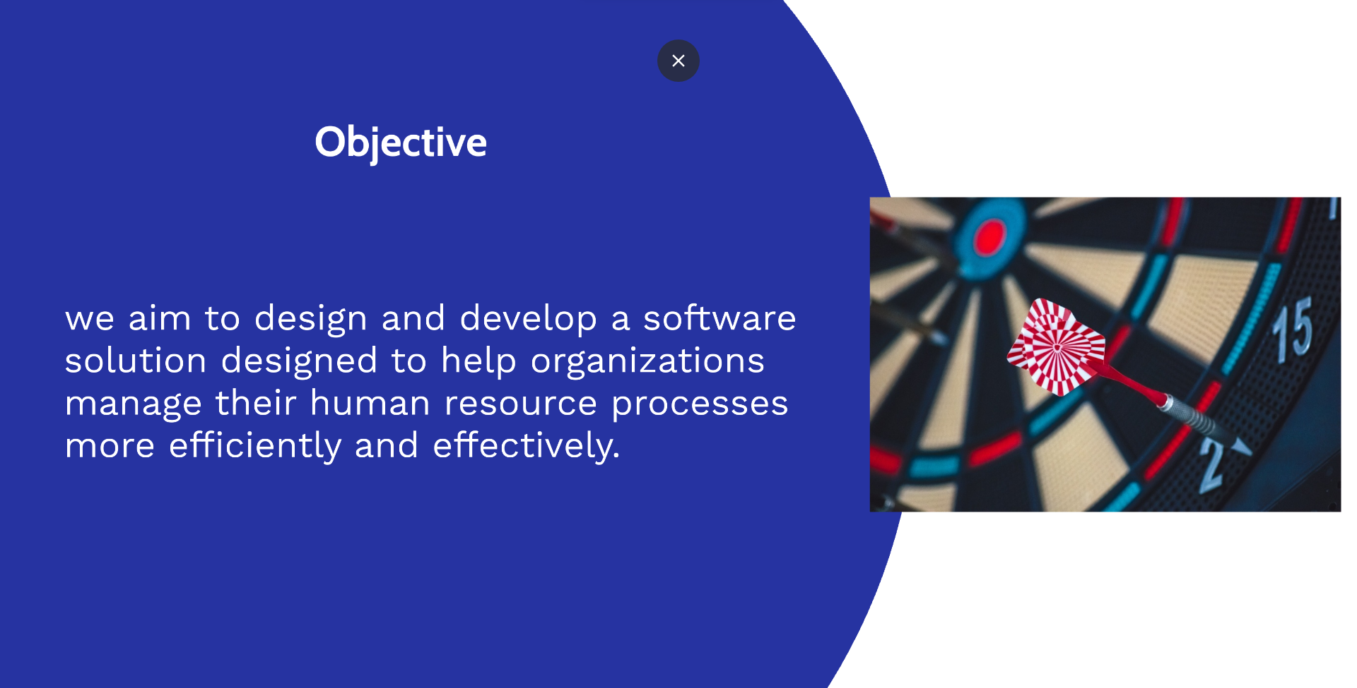

Project OverView
a software solution designed to help organizations manage their human resource processes more efficiently and effectively.
The goal of the project is to improve the efficiency and accuracy of HR processes, reduce manual errors, and increase transparency and accountability, ultimately helping organizations to better manage their human capital and improve their overall performance.

Slide 6
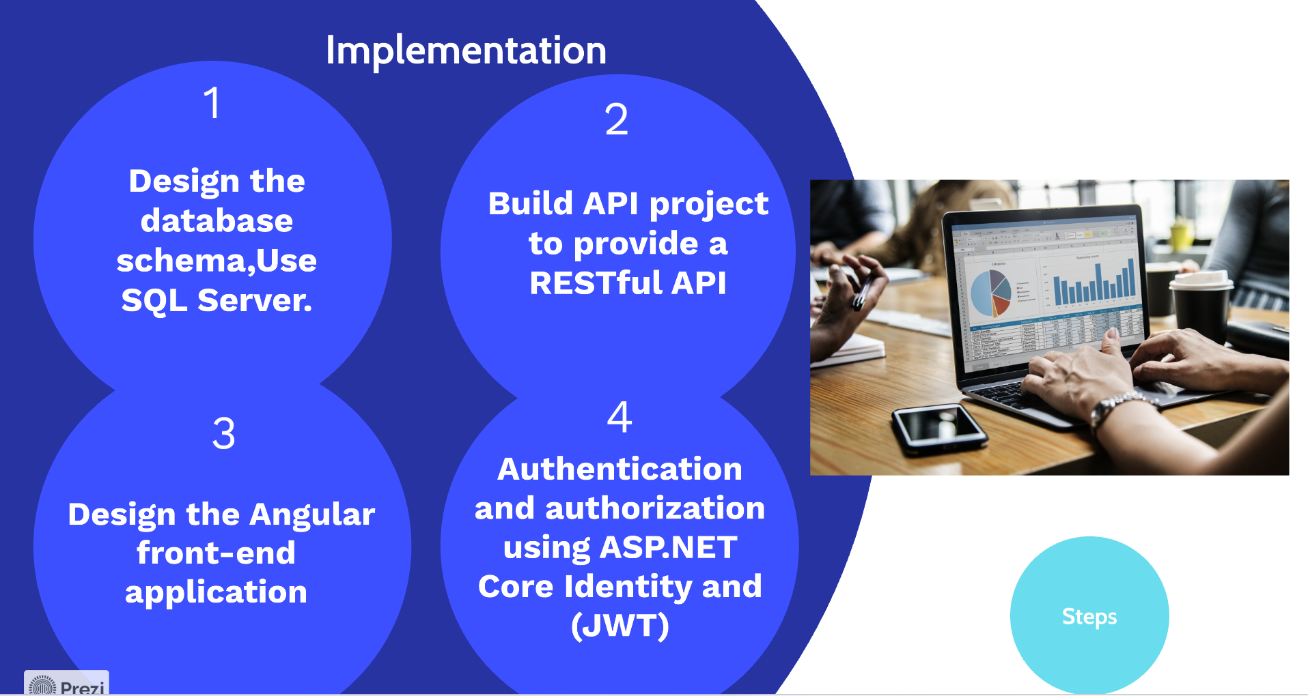
Implementation
Design the database schema,Use SQL Server as the database management system.
Set up the ASP.NET Core API project to provide a RESTful API .
Develop the Angular front-end application to consume the ASP.NET Core API endpoints and provide a user-friendly interface .
Implement authentication and authorization using ASP.NET Core Identity and JSON Web Tokens (JWT) to ensure secure access to the application and protect sensitive HR data.

Slide 7
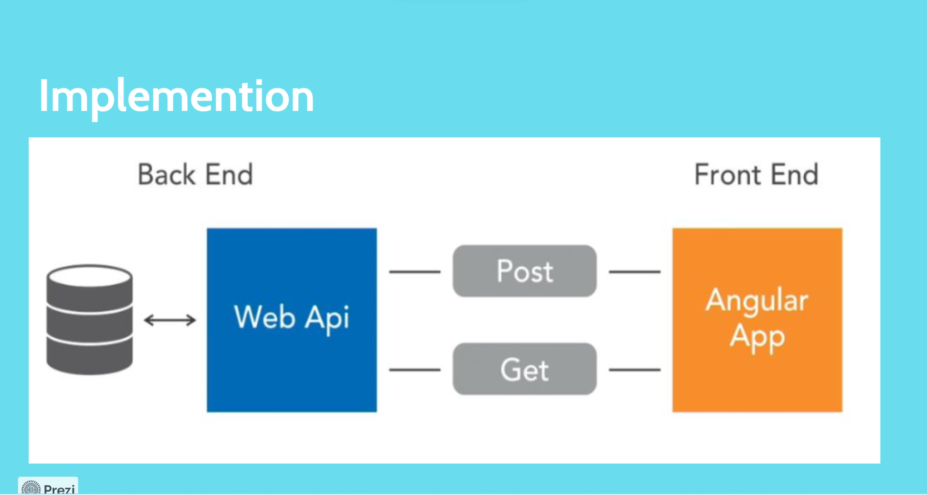

Slide 8
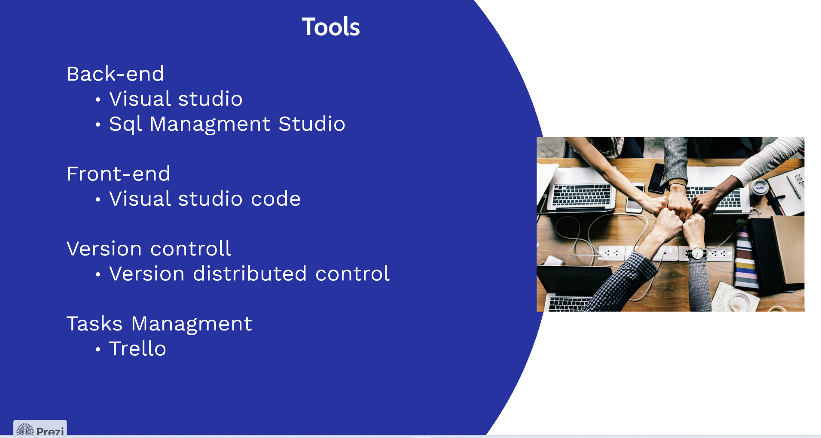
Agenda
Introduction
Project Overview
Implementation
Tools
Challenges and Solutions
Demo
Conclusion

Slide 9

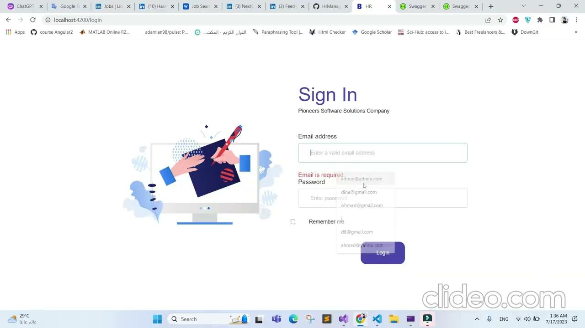
Agenda
Introduction
Project Overview
Implementation
Tools
Challenges and Solutions
Demo
Conclusion

Slide 10
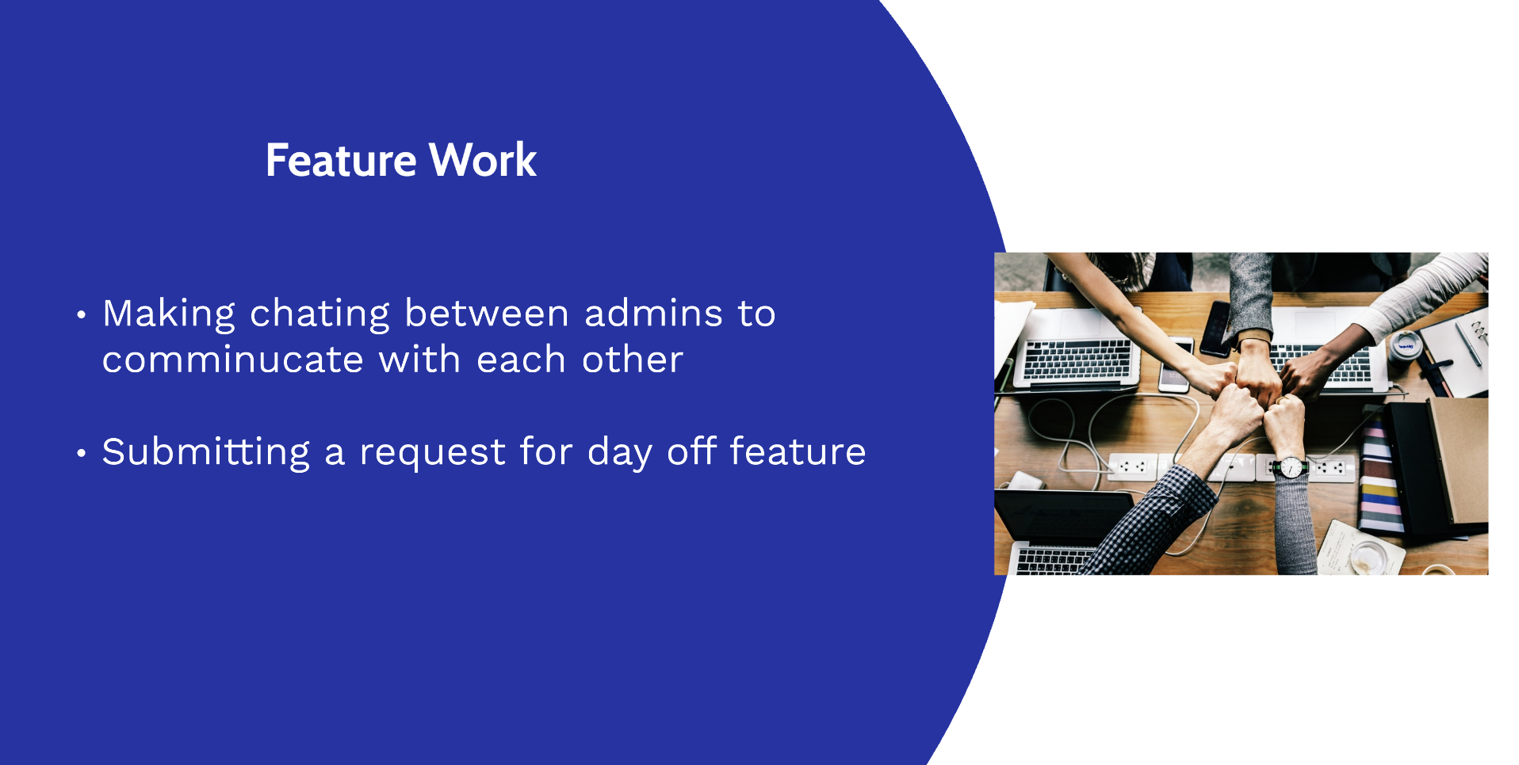
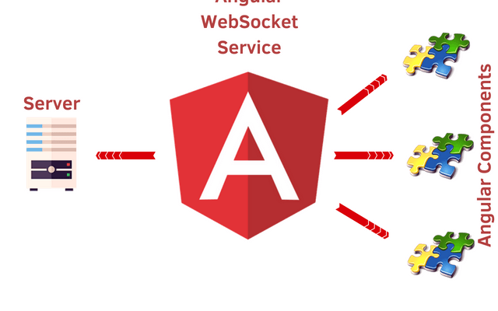
Challenges and Solutions
Challenge : Integrating the Angular front-end application with the ASP.NET Core API can be challenging, especially when dealing with complex data structures.
Solution: Use Angular services to encapsulate the API calls and provide a simplified interface for the front-end components. use HTTP interceptors to handle errors and provide consistent error handling throughout the application.

Slide 11
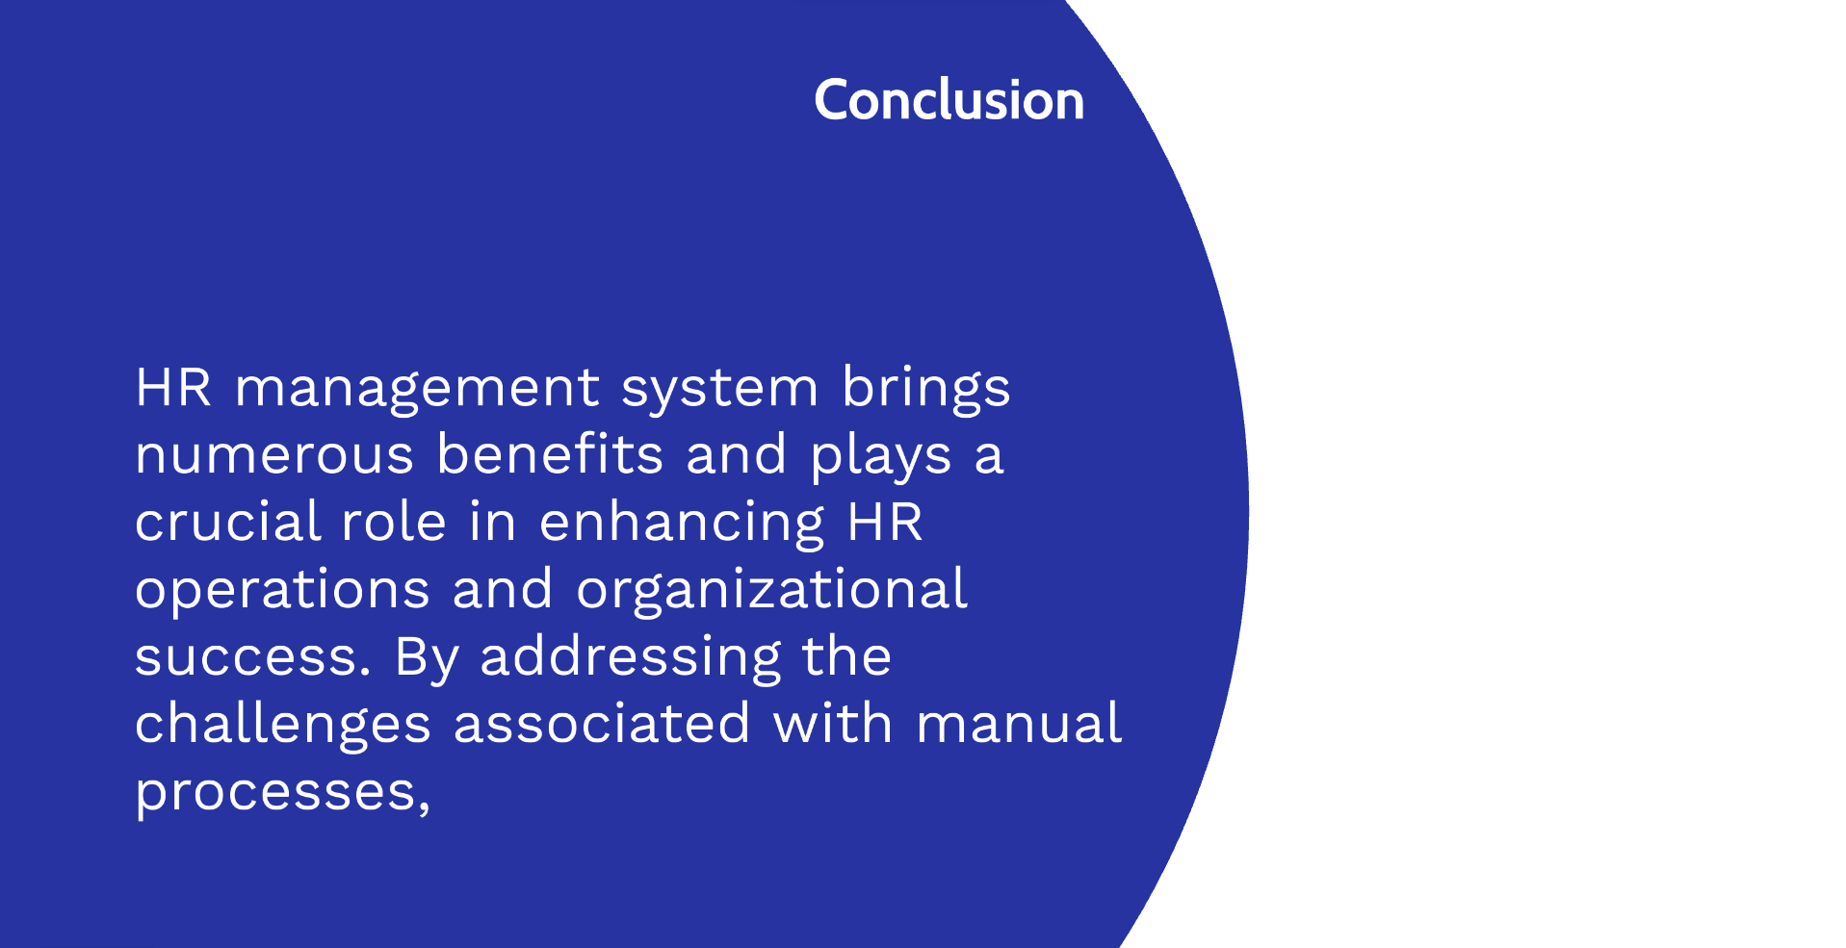
Demo

